Slide 1
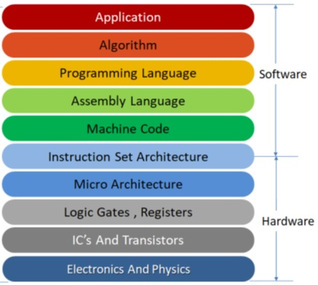
Instruction Set Architecture
Instructions: Commands for basic operations
Types and formats of instructions
Addressing modes of instructions
Machine codes of instructions
Data representation
Registers and uses
Memory address
Computer Engineers/Hardware Engineers must understand ISA to design/implement hardware details of a computer: Microarchitecture and it’s design using ICs, logic gates and associated components.

Slide 2
Micro-architecture
The level above the digital logic level is the microarchitecture level.
Its job is to implement the ISA (Instruction Set Architecture) level above it,
The design of the microarchitecture level depends on the ISA being implemented, as well as the cost and performance goals of the computer.
Many modern ISAs, particularly RISC designs, have simple instructions that can usually be executed in a single clock cycle.
More complex ISAs may require many cycles to execute a single instruction.
Executing an instruction may require locating the operands in memory, reading them, and storing results back into memory.

Slide 3
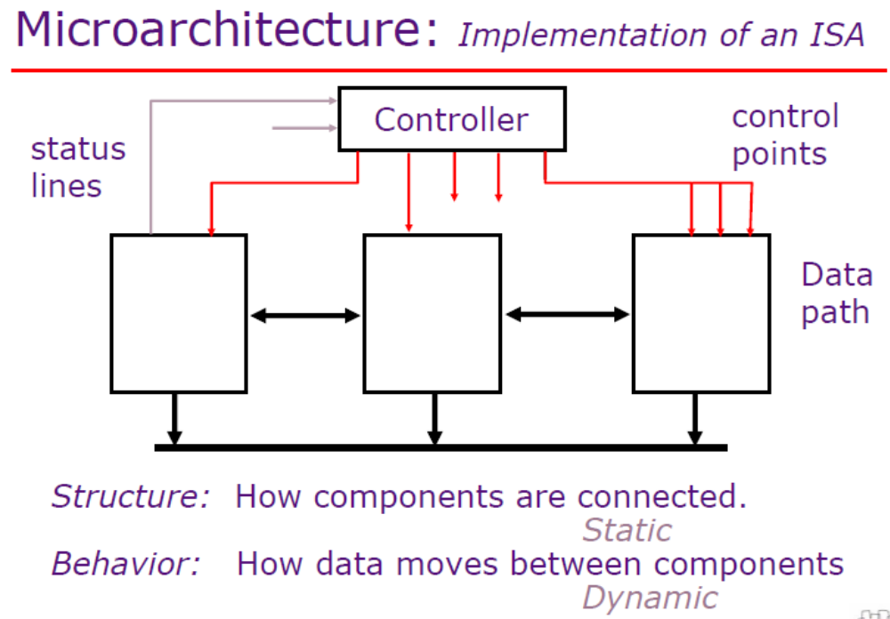

Slide 4
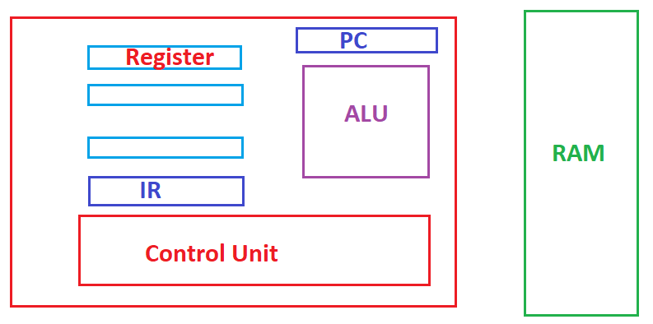
Microarchitecture
Design of Registers, ALU, Control Unit
How to interconnect these and how to control/flow information among these
How to select particular operation in ALU
How to select particular registers (read/write)
How to access memory (read/write)

Slide 5
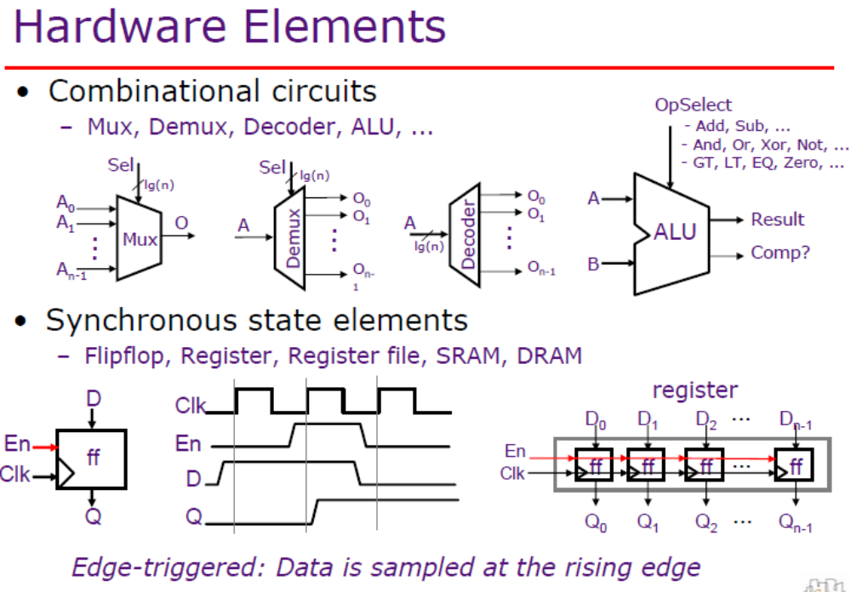

Slide 6
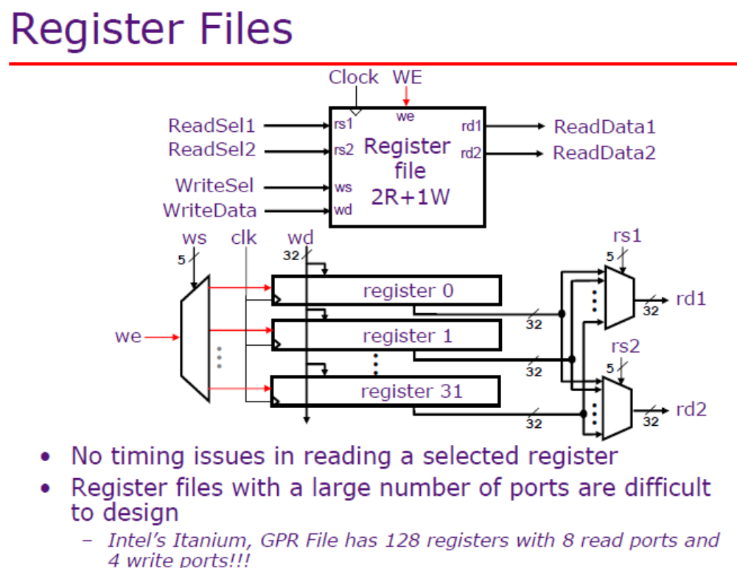

Slide 7
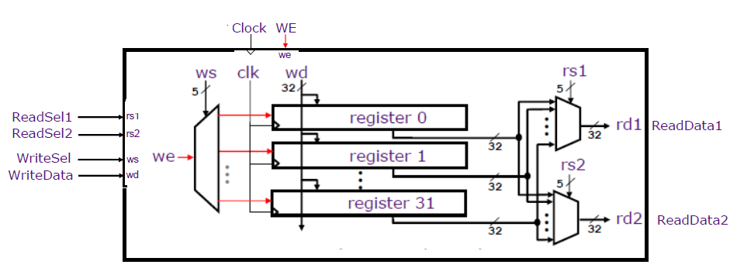

Slide 8
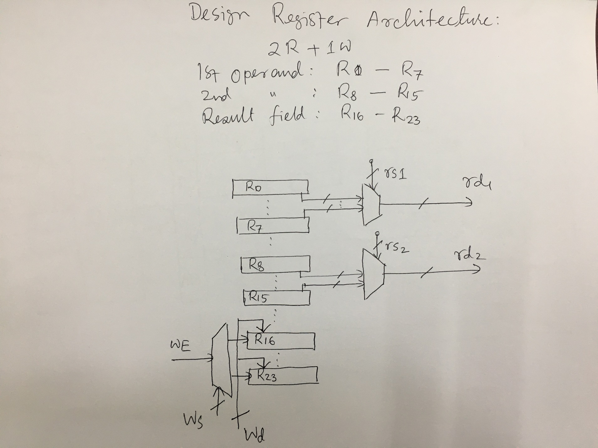

Slide 9
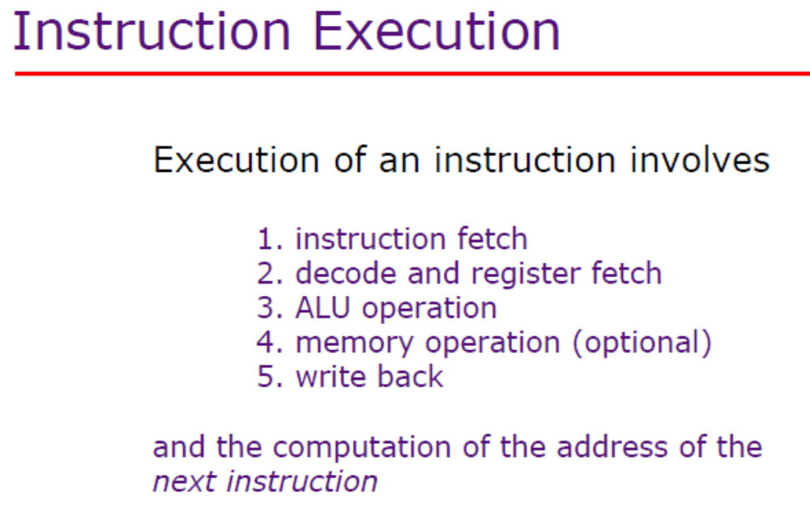

Slide 10

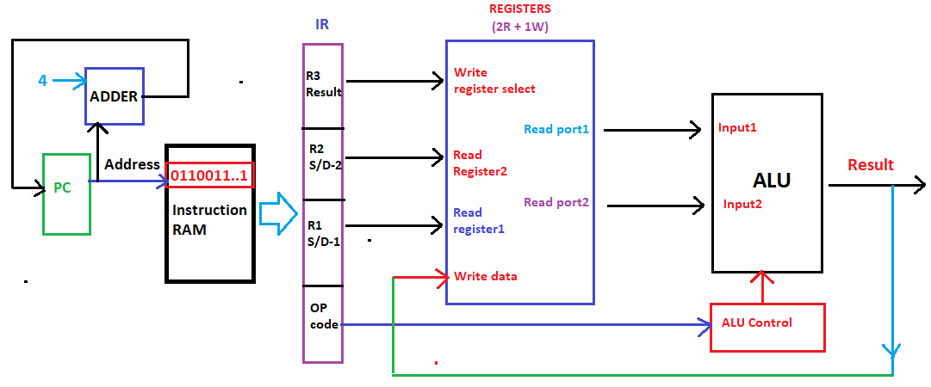

Slide 11


Slide 12


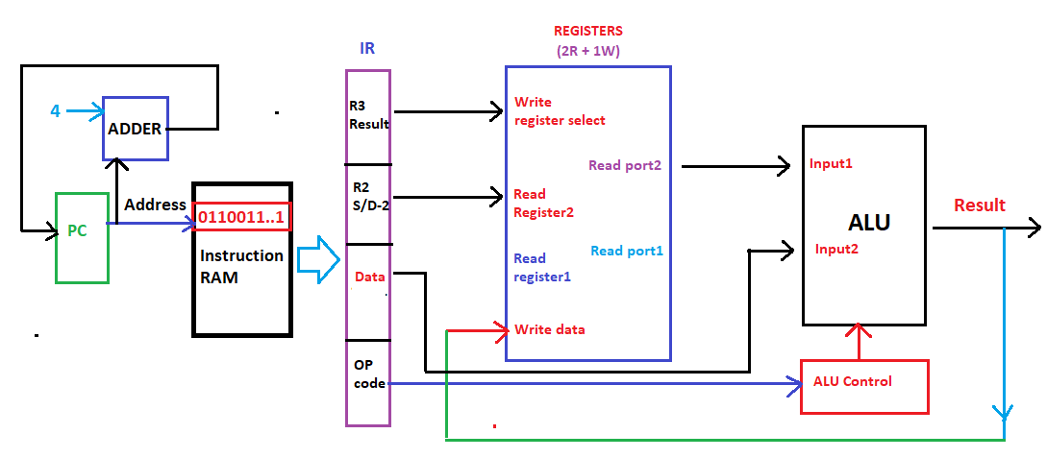

Slide 13

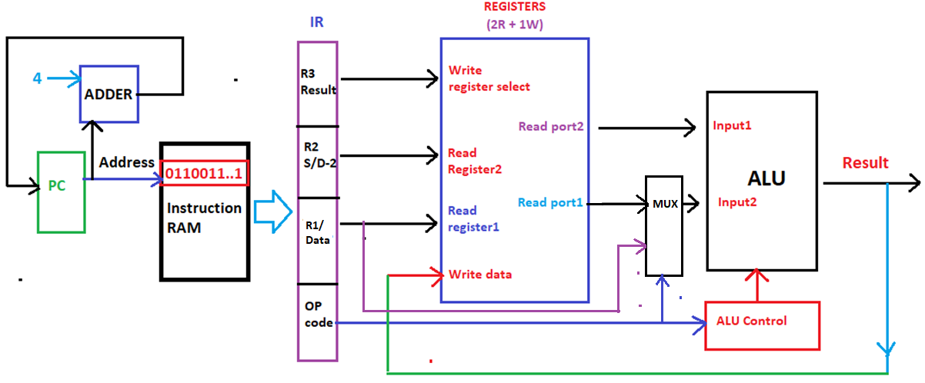

Slide 14


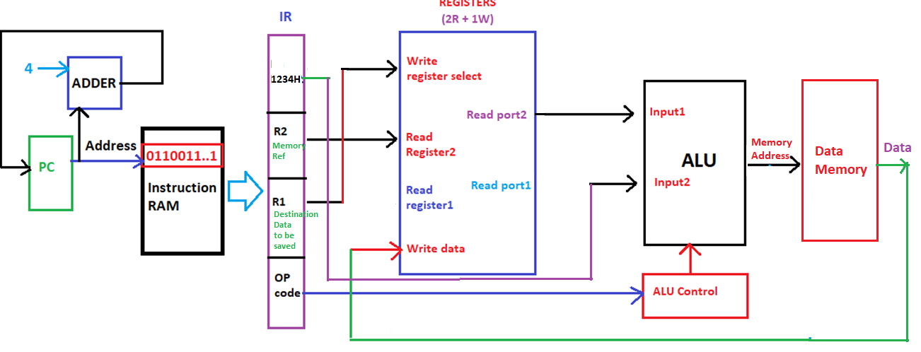

Slide 15

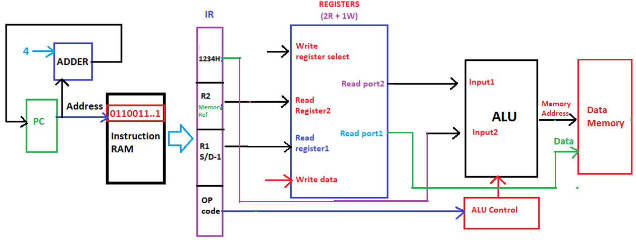

Slide 16
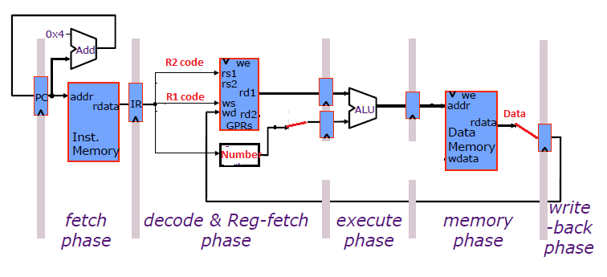
LOAD Instruction
LOAD | R1 (Destination) | NUMBER (R2) (Source field)

Slide 17
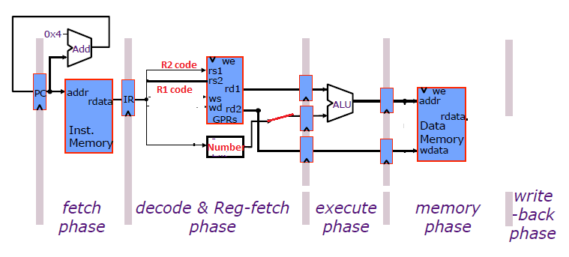
STORE Instruction
STORE | R1 (SOURCE) | NUMBER (R2) (DESTINATION)

Slide 18
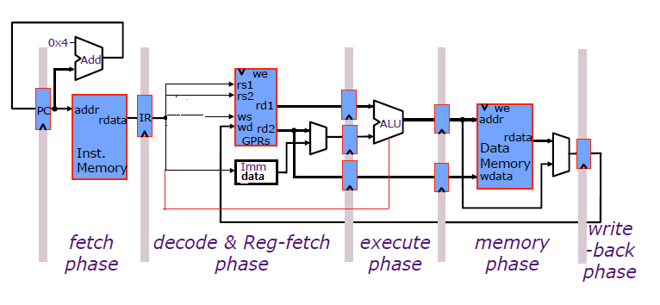
Pipelined datapath

Slide 19
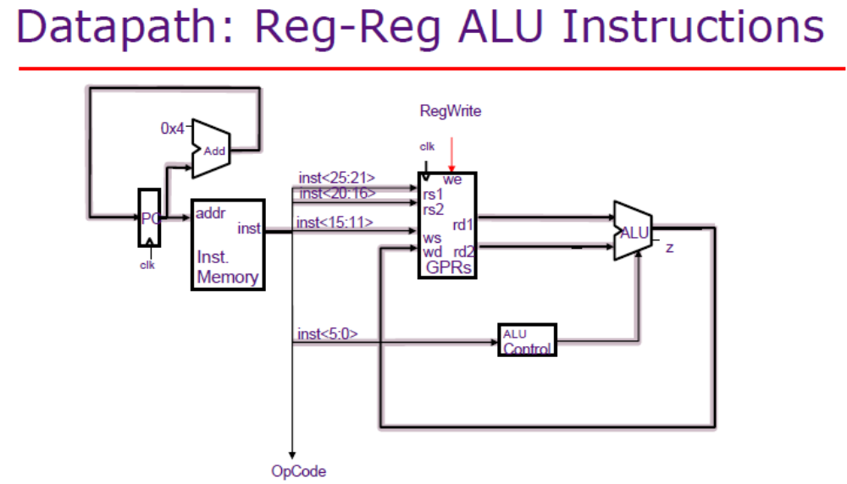



Slide 20
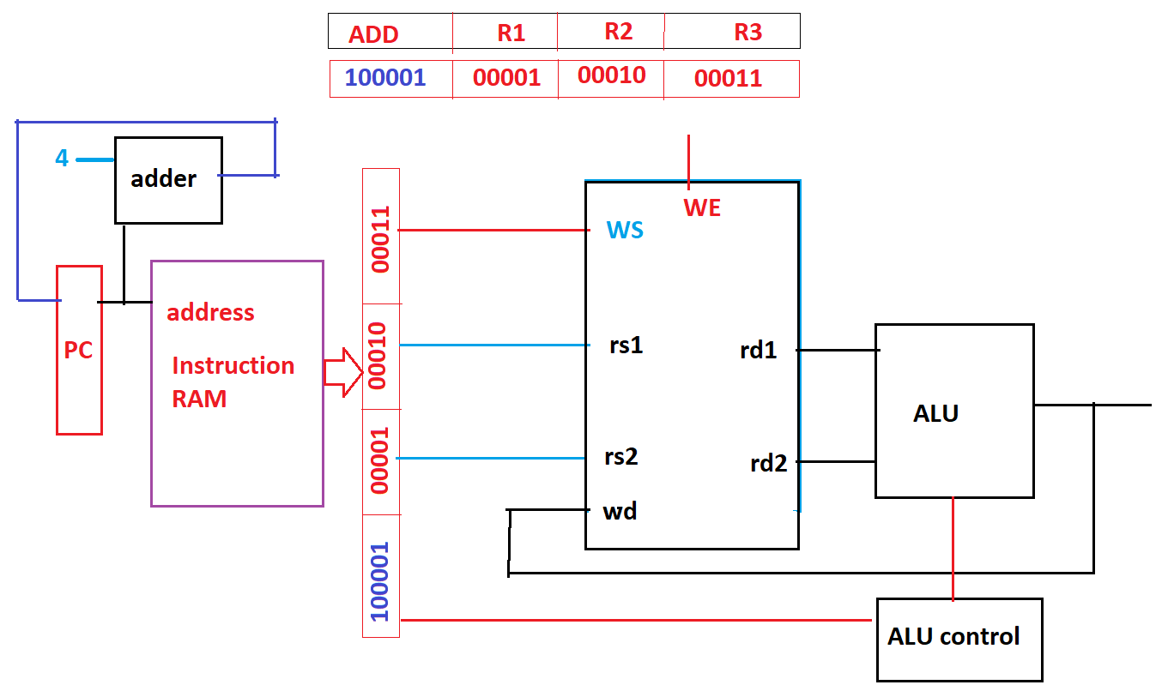

Slide 22
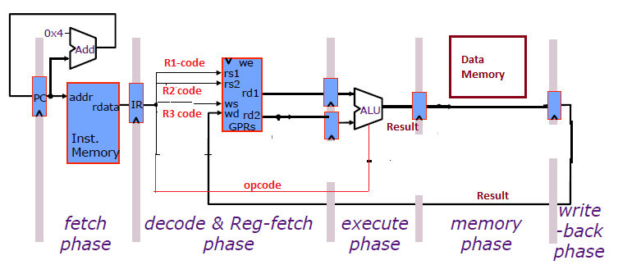
Datapath design: ALU Instruction (RISC)
ADD | R1 (Data-1) | R2 (Data-2) | R3 (result field)

Slide 23
LOAD Instruction
LOAD | R1 (Destination) | NUMBER (R2) (Source field)

Slide 24
STORE Instruction
STORE | R1 (SOURCE) | NUMBER (R2) (DESTINATION)

